Slide 1
Philips Home Appliances

Slide 2
Price Range – 500-2000

Slide 3
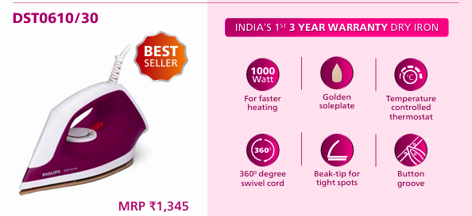
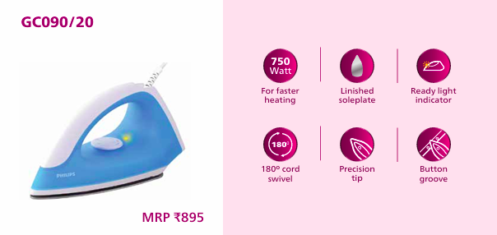
Price – Rs. 925 MOQ- 50-100units
Price – Rs. 625 MOQ- 50-100units

Slide 4
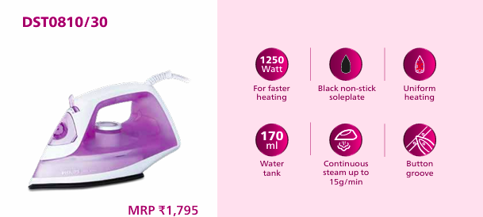
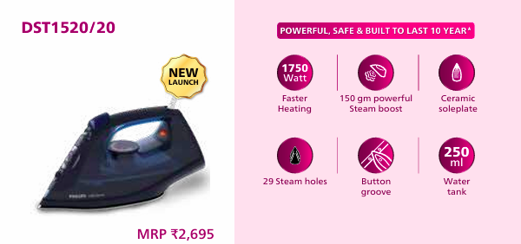
Price – Rs. 1225 MOQ- 50-100units
Price – Rs. 1850 MOQ- 50-100units

Slide 5
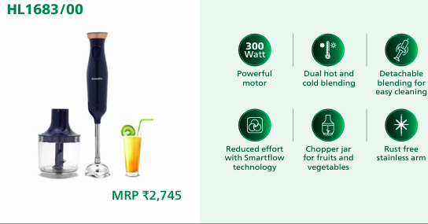
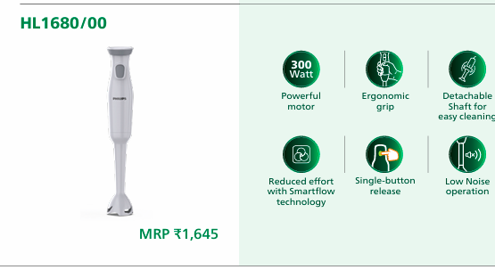
Price – Rs. 2050 MOQ- 50-100units
Price – Rs. 1225 MOQ- 50-100units

Slide 6
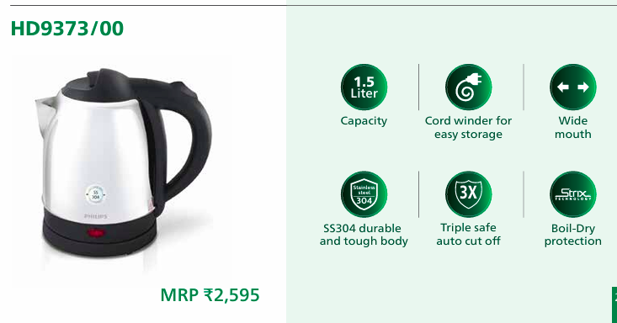
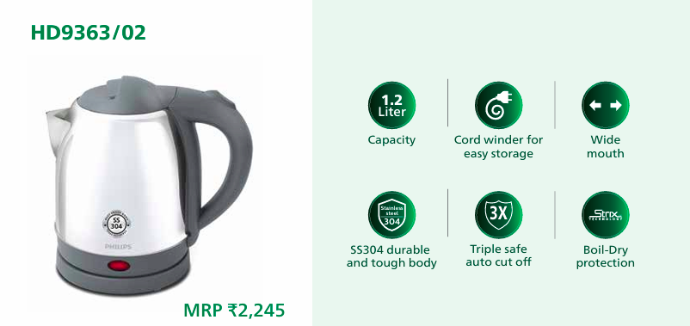
Price – Rs. 1650 MOQ- 50-100units
Price – Rs. 1925 MOQ- 50-100units

Slide 7
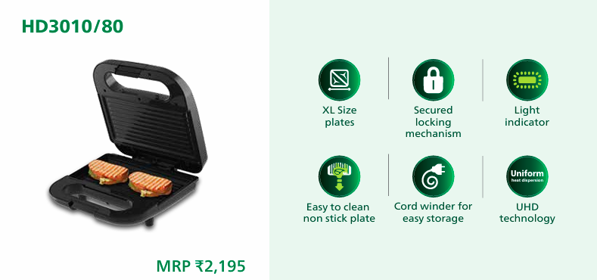
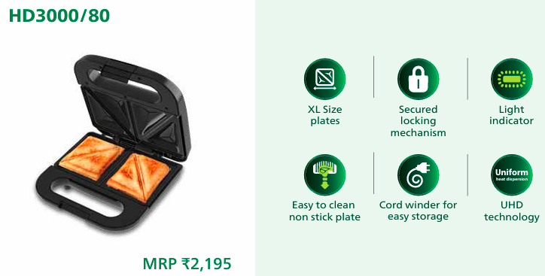
Price – Rs. 1625 MOQ- 50-100units
Price – Rs. 1625 MOQ- 50-100units

Slide 8
Price Range – 2000-4000

Slide 9
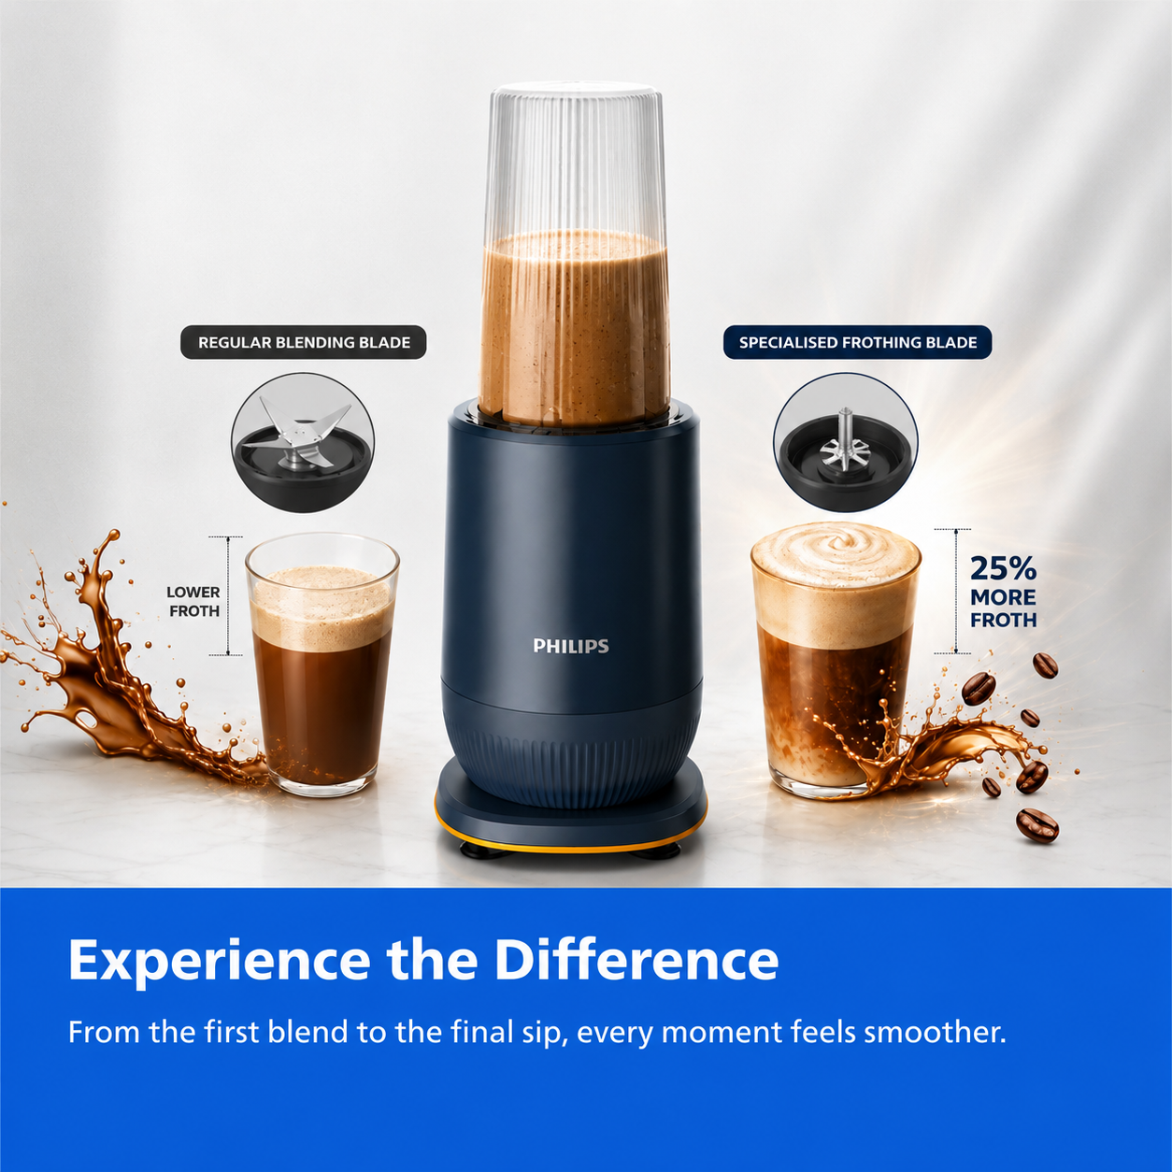
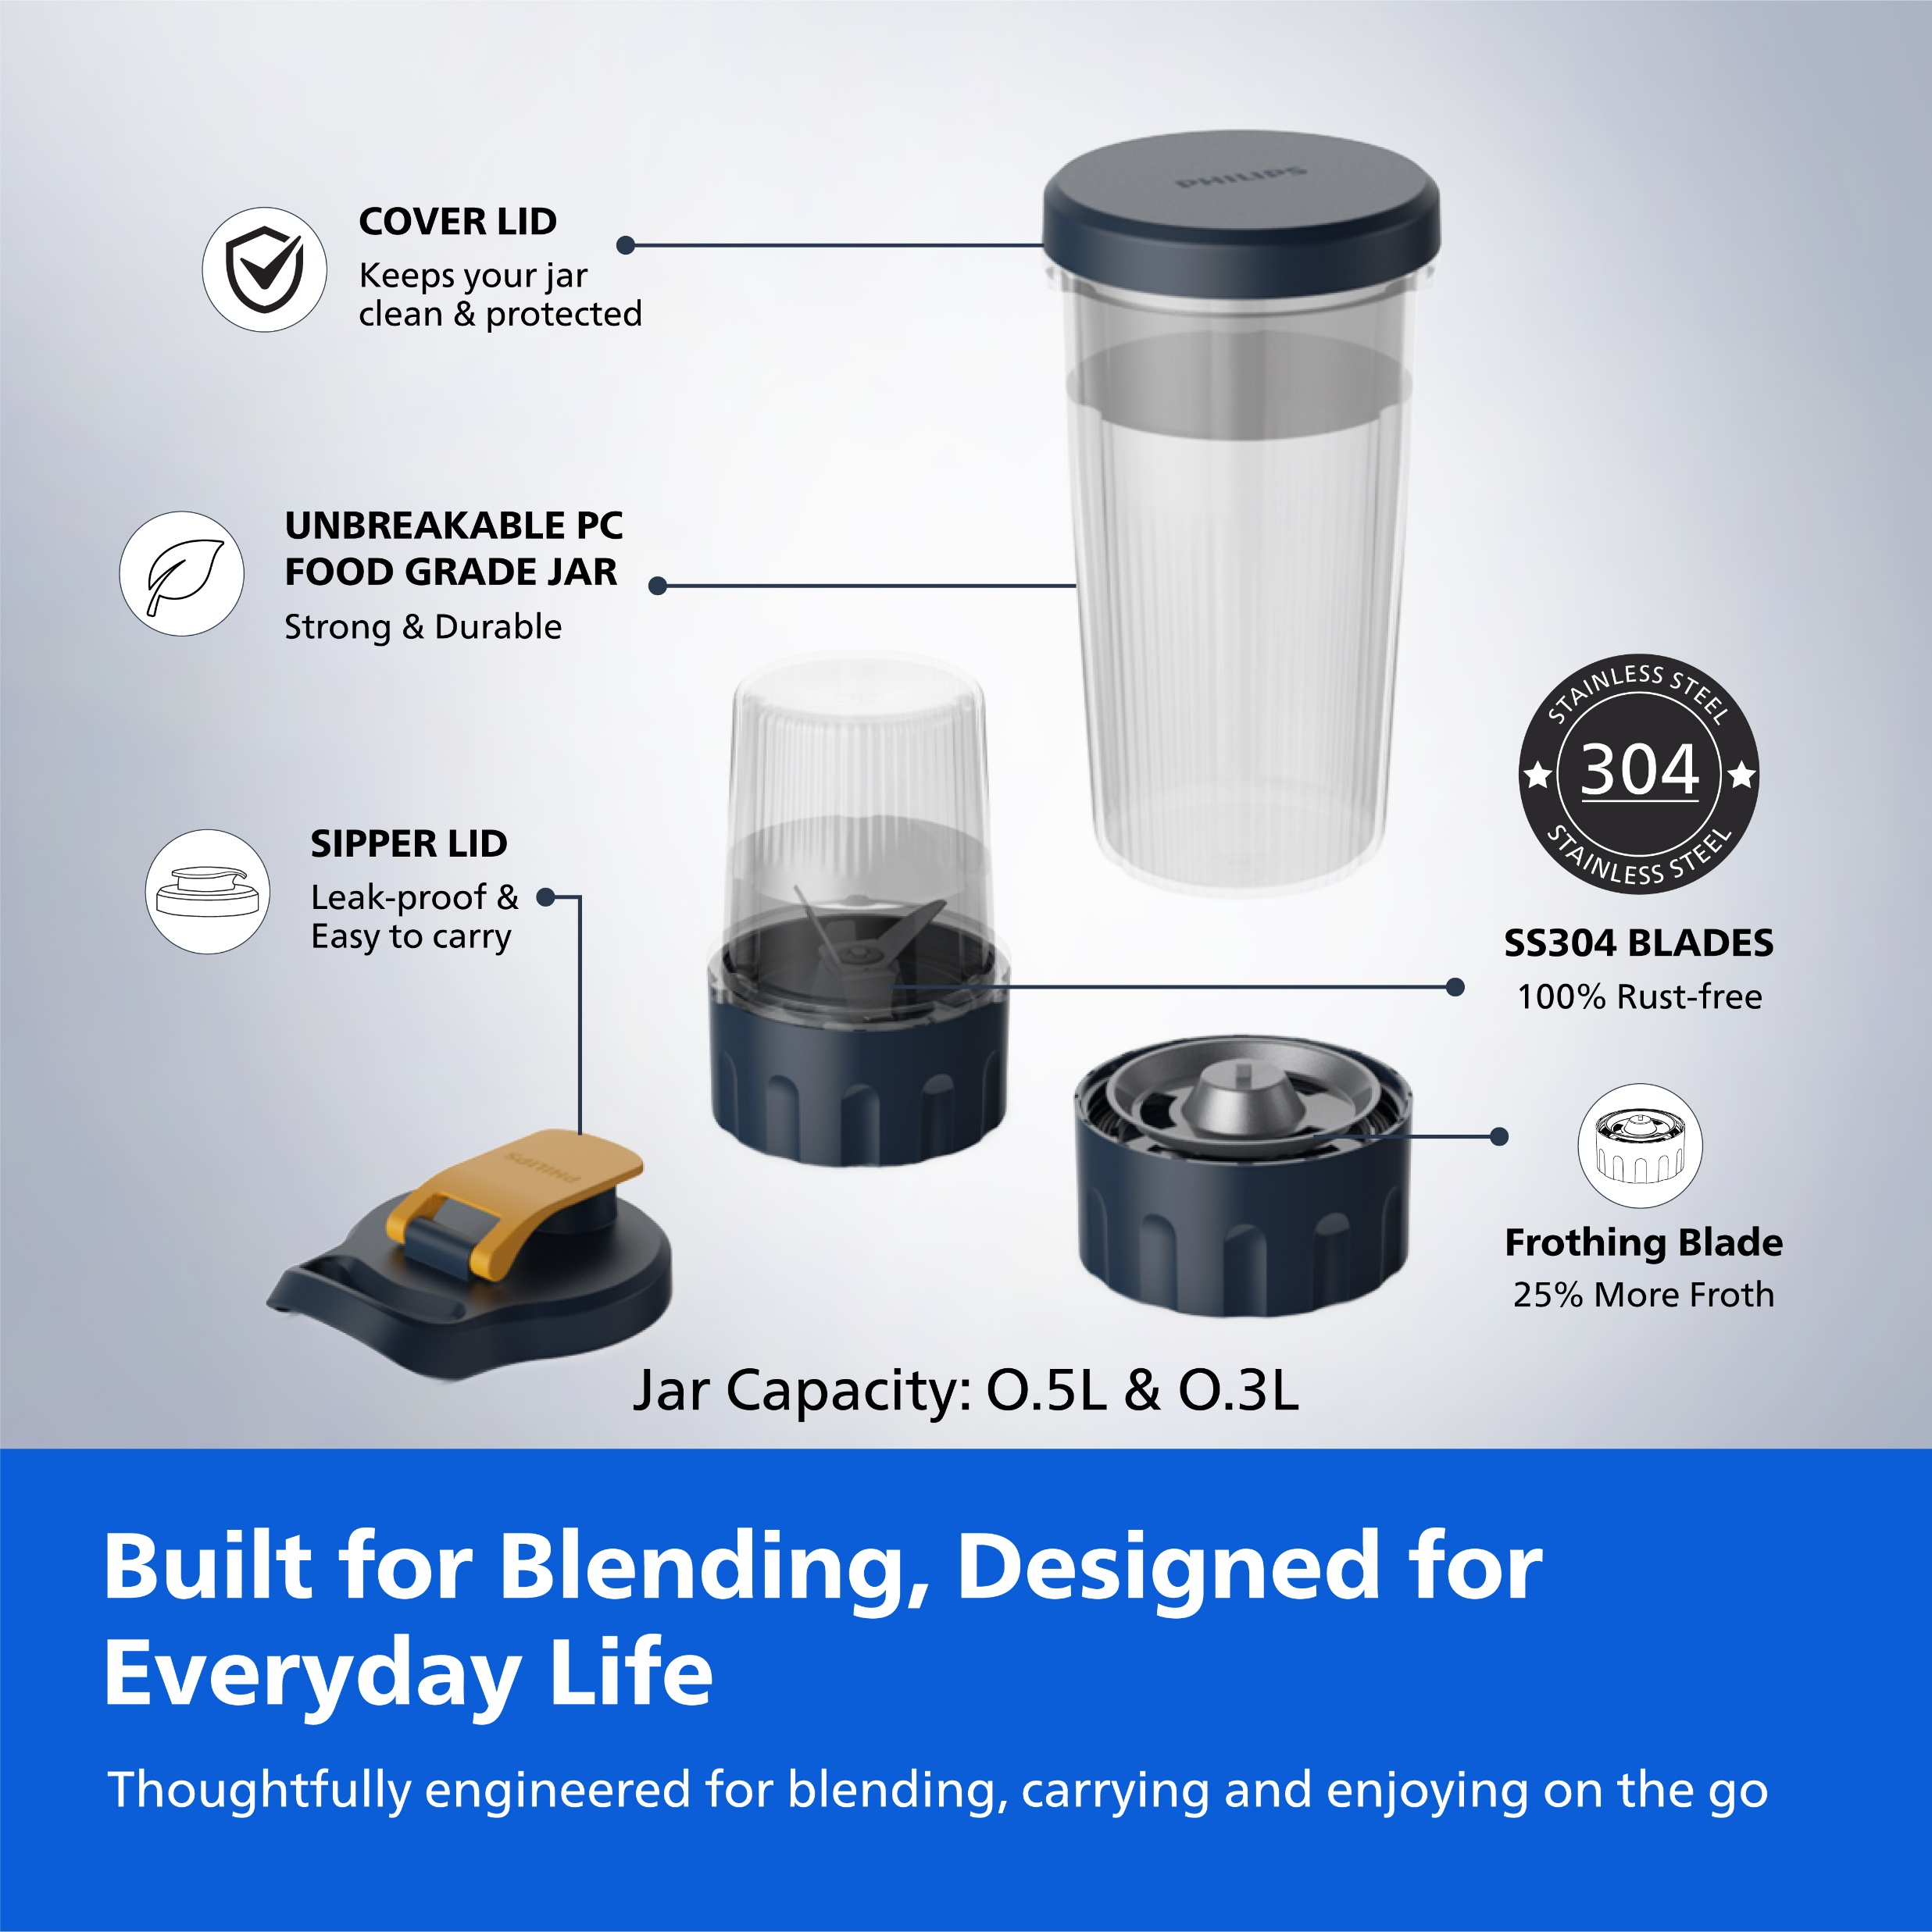
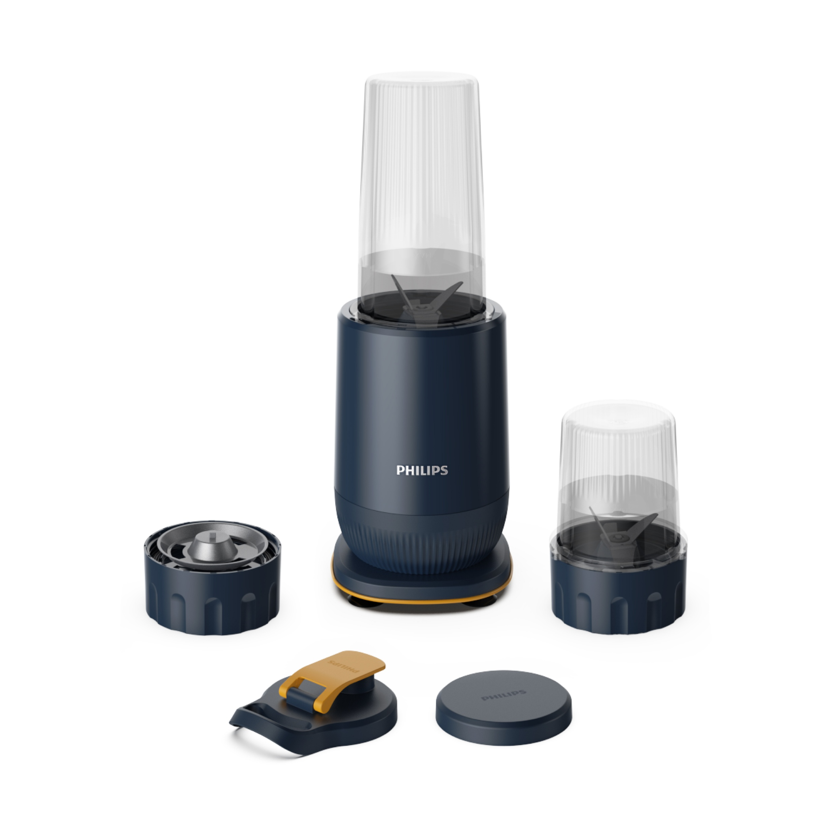
Philips Mini Blender
HR 2612 [2 Jars]
One 0.5L + One 0.3L Inverted Jars
MRP Price | 3,295 2,400
HR 2613 [3 Jars]
Two 0.5L + One 0.3L Inverted Jars with Frothing Blade
MRP Price | 3,795 2,650

Slide 10
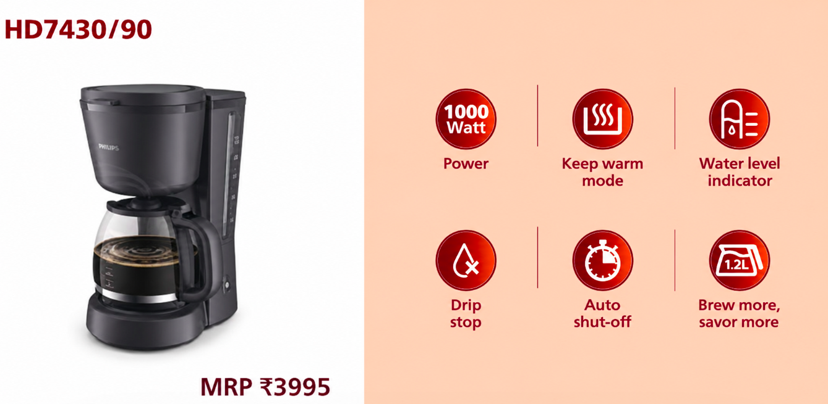
Price – Rs. 2900 MOQ- 100units

Slide 11
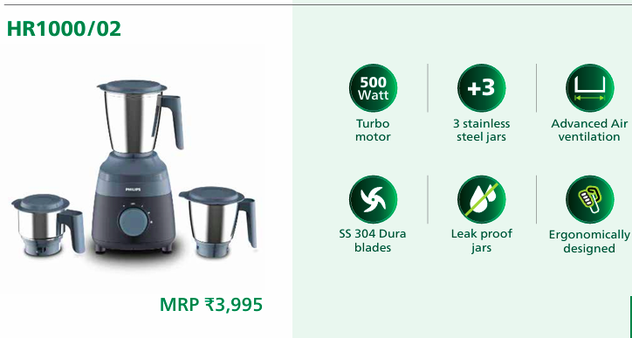
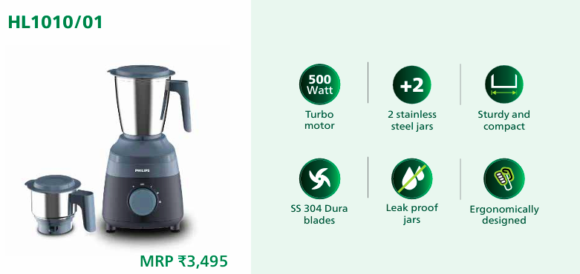
Price – Rs. 2400 MOQ- 50-100units
Price – Rs. 2650 MOQ- 50-100units

Slide 12
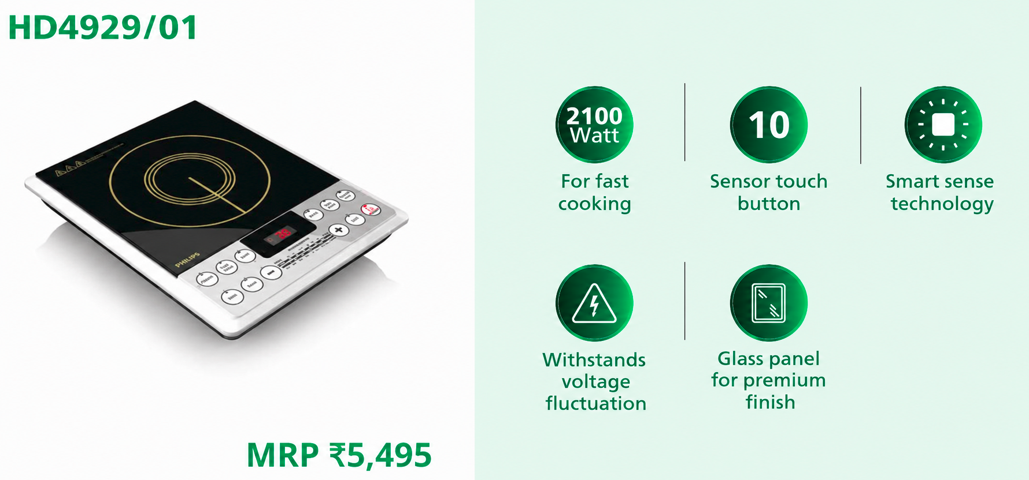
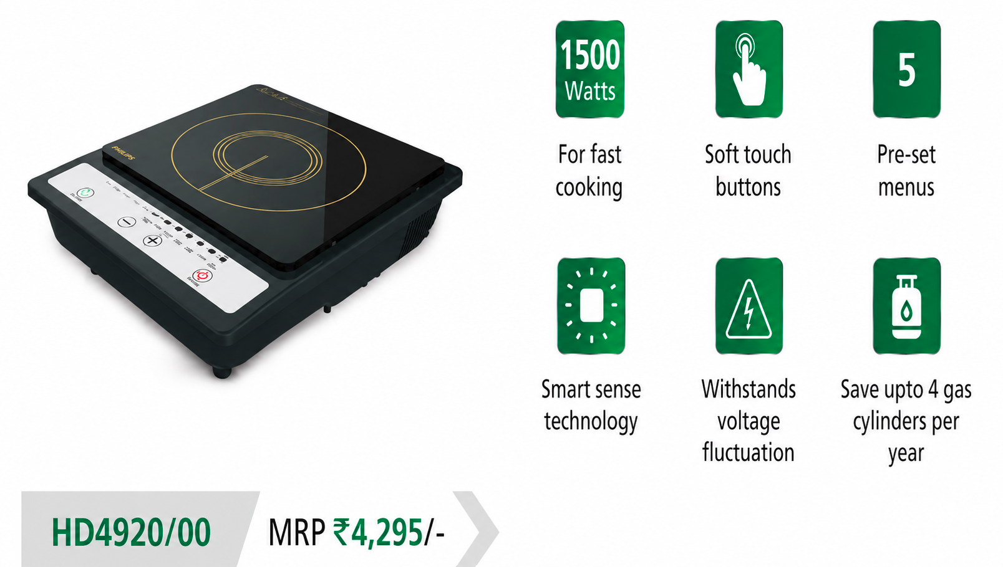
Price – Rs. 3750 MOQ- 50-100 units
Price – Rs. 2900 MOQ- 50-100 units

Slide 13
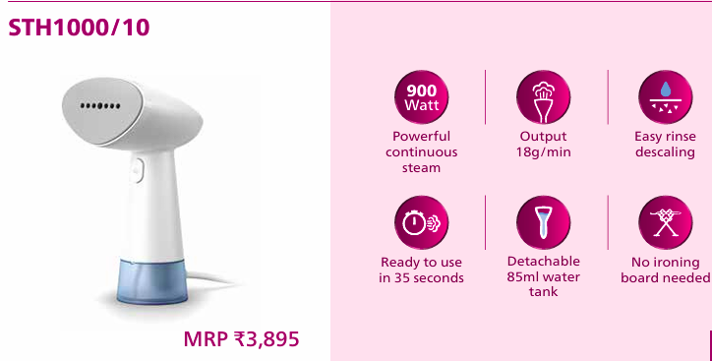
Price – Rs. 2700 MOQ- 100 units

Slide 14
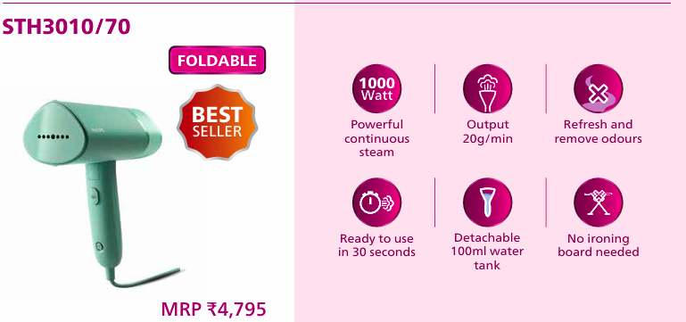
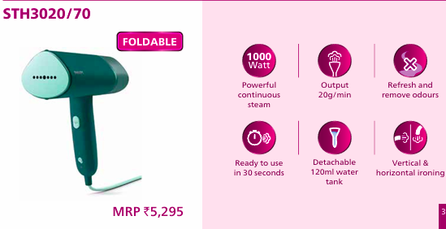
Price – Rs. 3400 MOQ- 100 units
Price – Rs. 3600 MOQ- 100 units

Slide 15
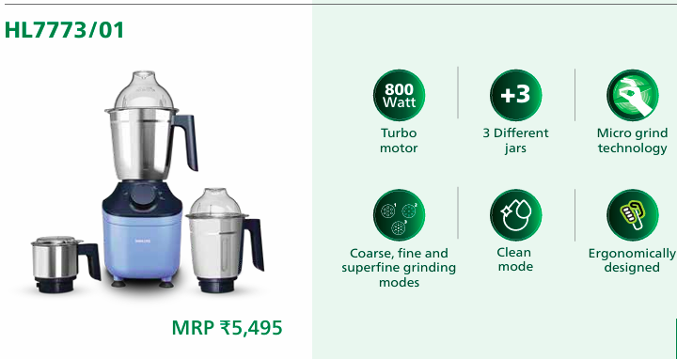
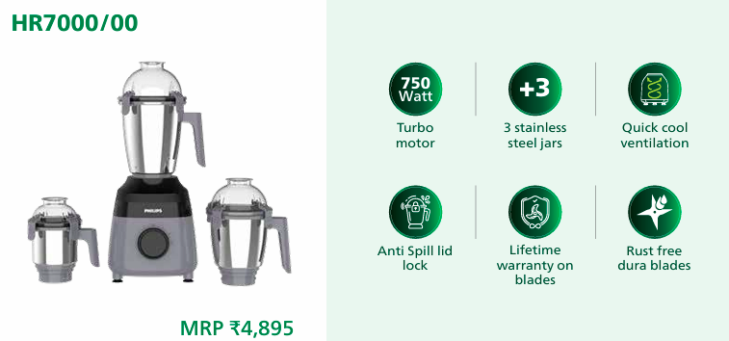
Price – Rs. 3400 MOQ- 100 units
Price – Rs. 3750 MOQ- 100 units

Slide 16
Price Range – 4000-6000

Slide 17
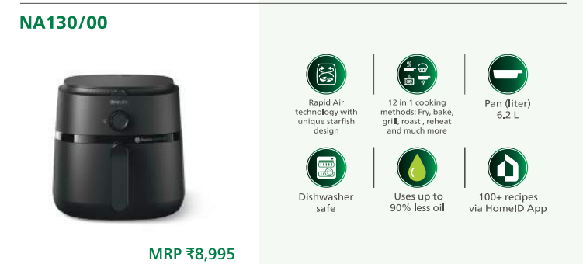
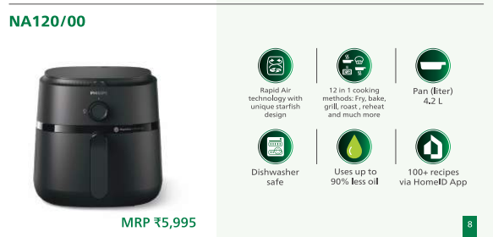
Price – Rs. 6100
MOQ- 100 units
Price – Rs. 4100
MOQ- 100 units

Slide 18
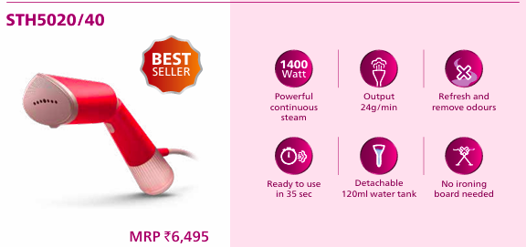
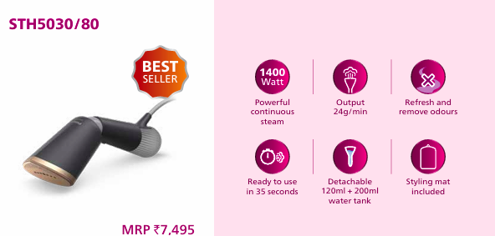
Price – Rs. 4450 MOQ- 100 units
Price – Rs. 5150 MOQ- 100 units

Slide 19
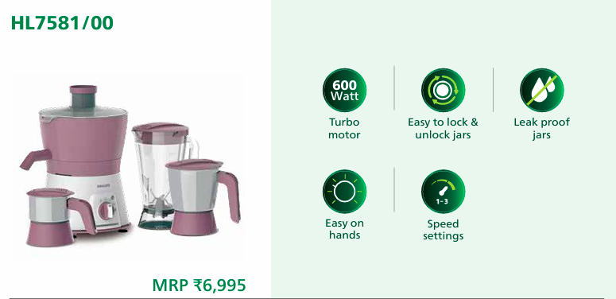
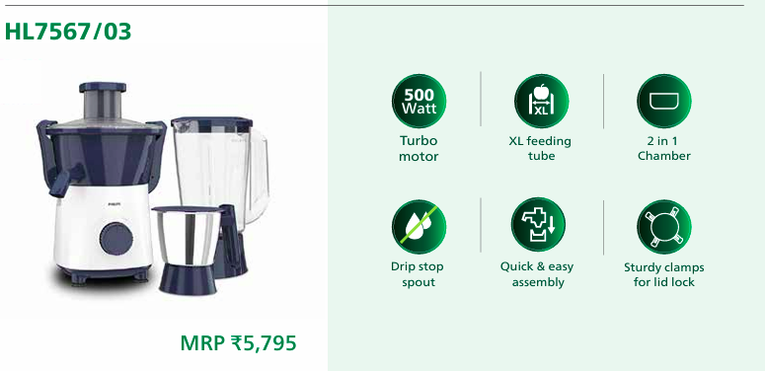
Price – Rs. 4850 MOQ- 100 units
Price – Rs. 4000 MOQ- 100 units

Slide 20
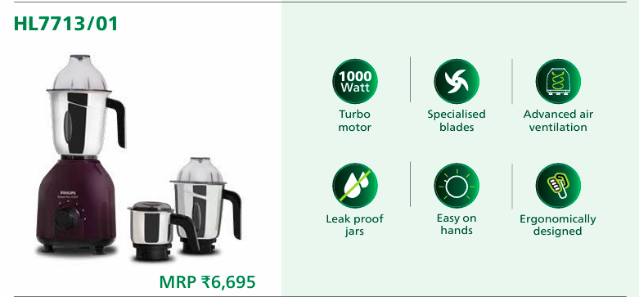
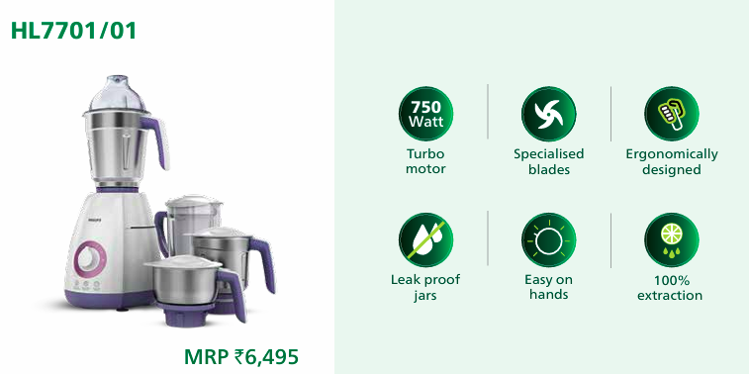
Price – Rs. 4650 MOQ- 100 units
Price – Rs. 4500 MOQ- 100 units

Slide 21
Price Range – 6000-10000

Slide 22
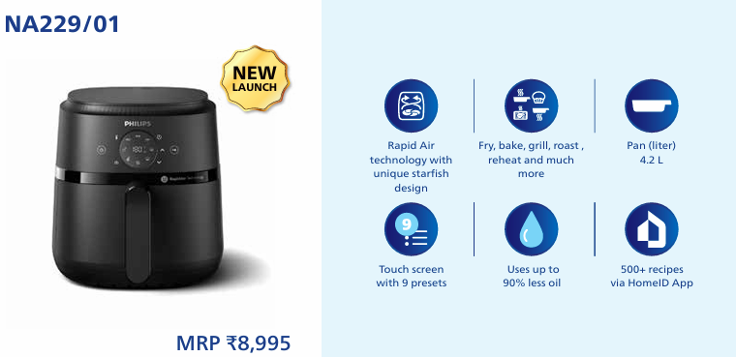
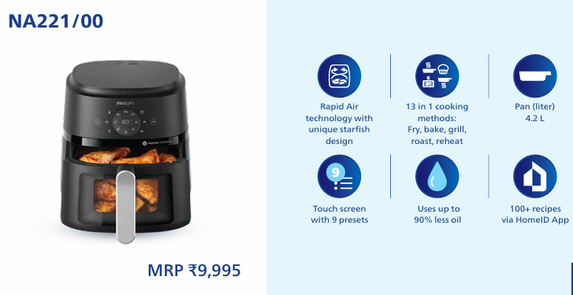
Price – Rs. 6150 MOQ- 50 units
Price – Rs. 6850 MOQ- 50 units

Slide 23
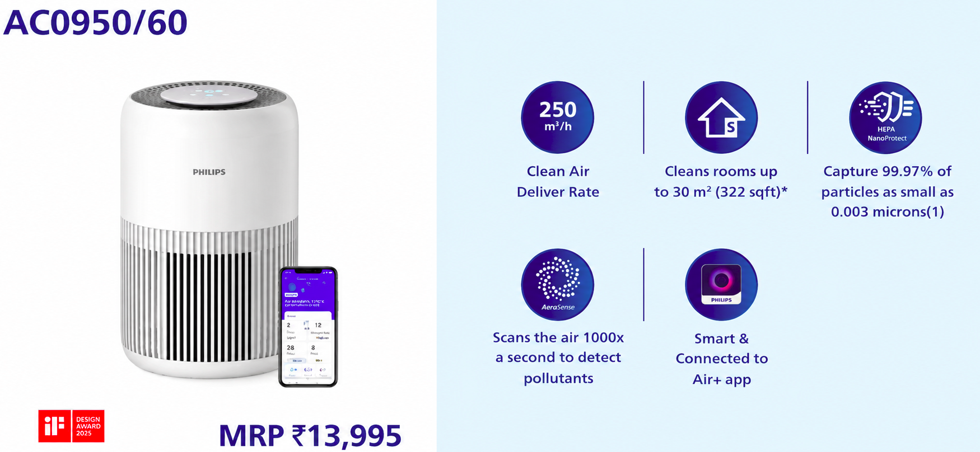
Price – Rs. 10500 MOQ- 50 units

Slide 24
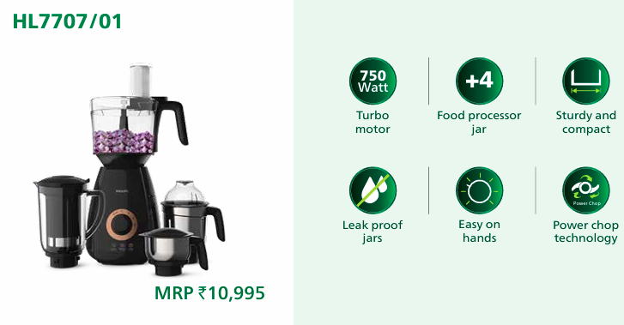
Price – Rs. 7600 MOQ- 25-50 units

Slide 25
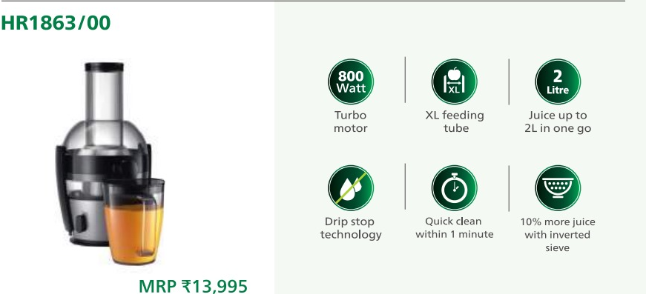
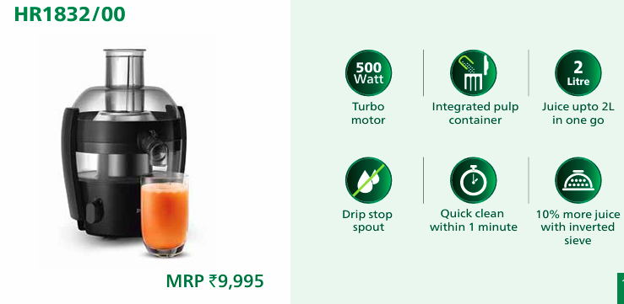
Price – Rs. 9650 MOQ- 25-50 units
Price – Rs. 6800 MOQ- 25-50 units

Slide 26
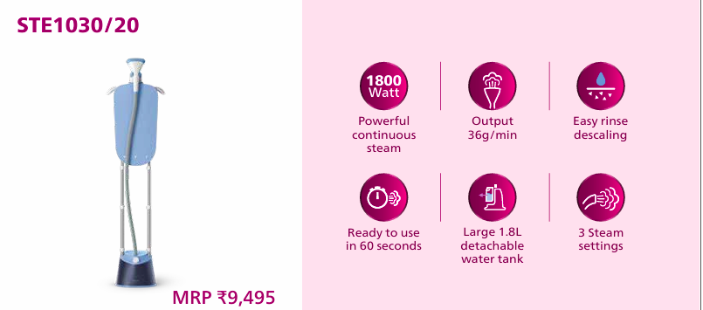
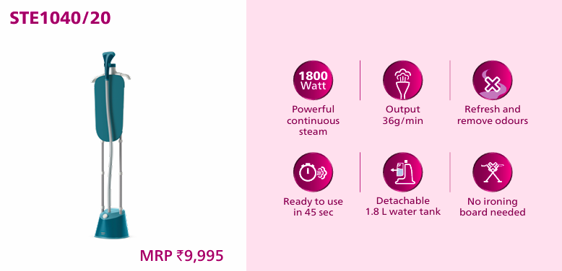
Price – Rs. 6500 MOQ- 100 units
Price – Rs. 6800 MOQ- 100 units

Slide 27
Price Range –10000+

Slide 28
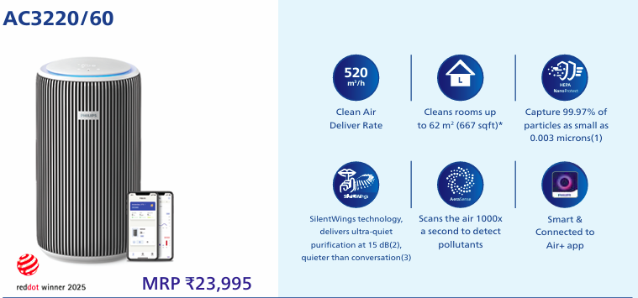
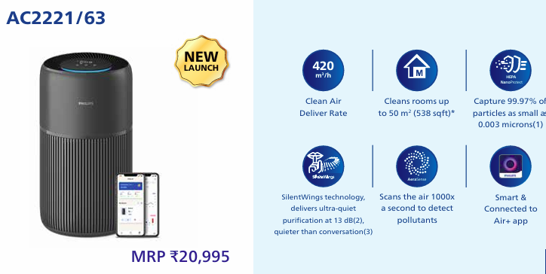

Slide 29
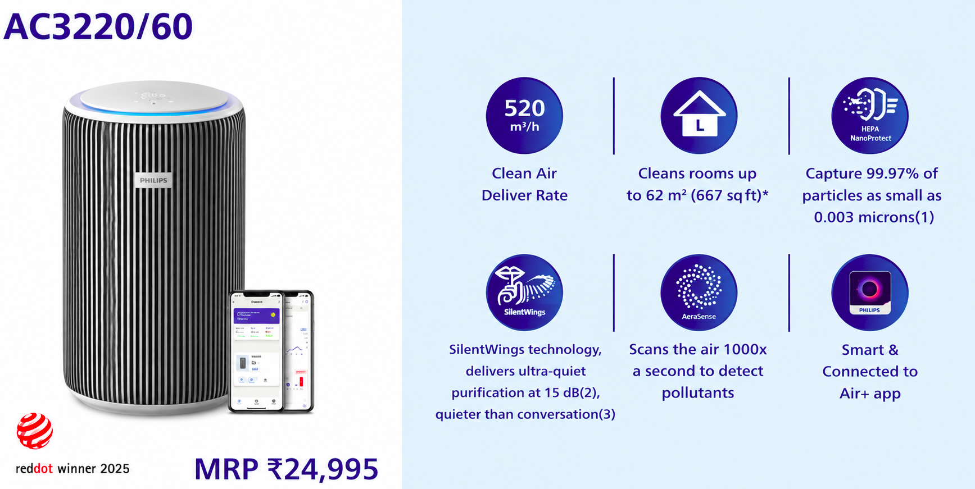
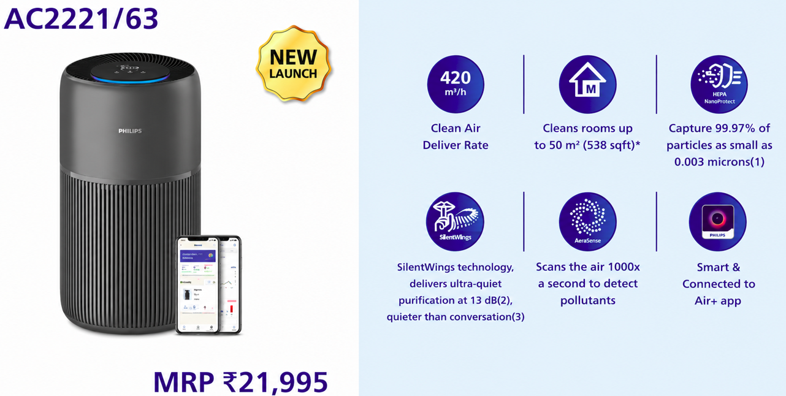
Price – Rs.18500 MOQ- 50-100 units
Price – Rs.16500 MOQ- 50-100 units

Slide 30
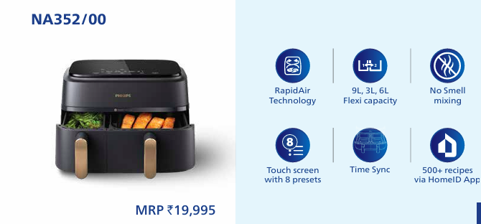
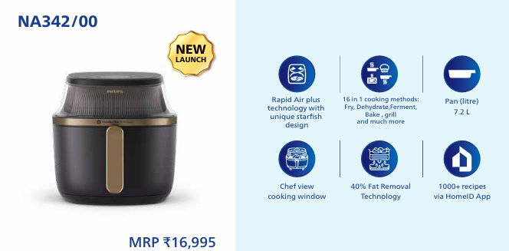
Price – Rs.14000 MOQ- 50-100 units
Price – Rs.12000 MOQ- 50-100 units

Slide 31
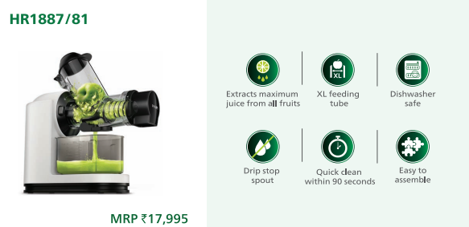
MRP – Rs. 17995 Price – Rs. 13500 MOQ- 50-100units

Slide 32
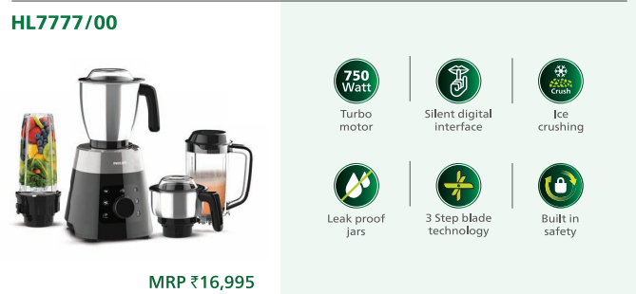
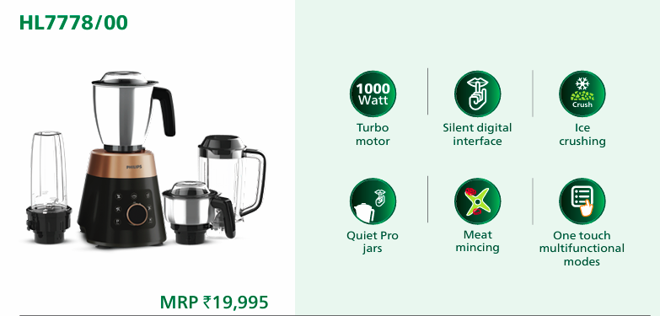
Price – Rs.11500 MOQ- 25-50 units
Price – Rs.13500 MOQ- 25-50 units

Slide 33
Thank You

